Slide 1

Ulster County CARES II Small Business Assistance Program
Board of Directors Meeting
April 11, 2023

Slide 2
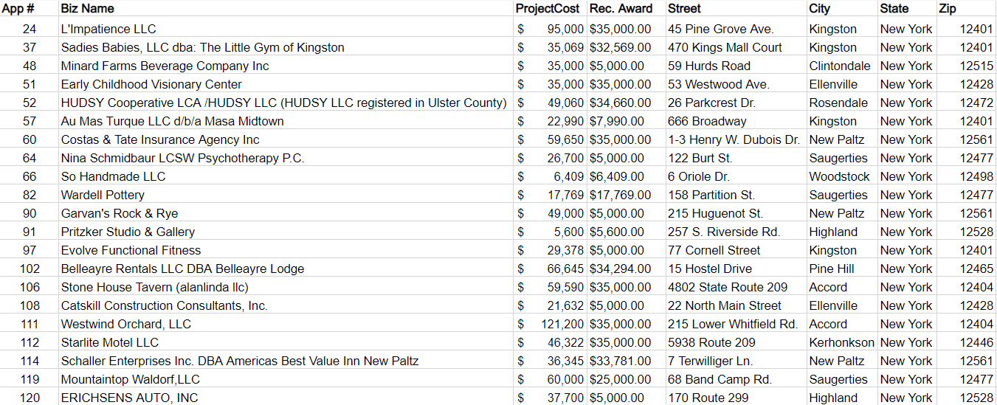
Evaluation Committee Recommendation for Award

Slide 3
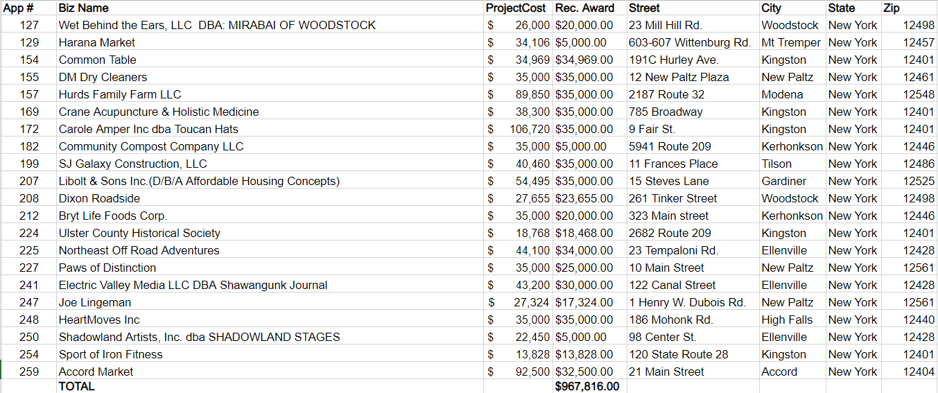
Evaluation Committee Recommendation for Award (cont.)

Slide 4
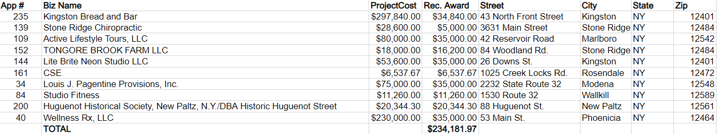
Additional Award Recommendations

Slide 5
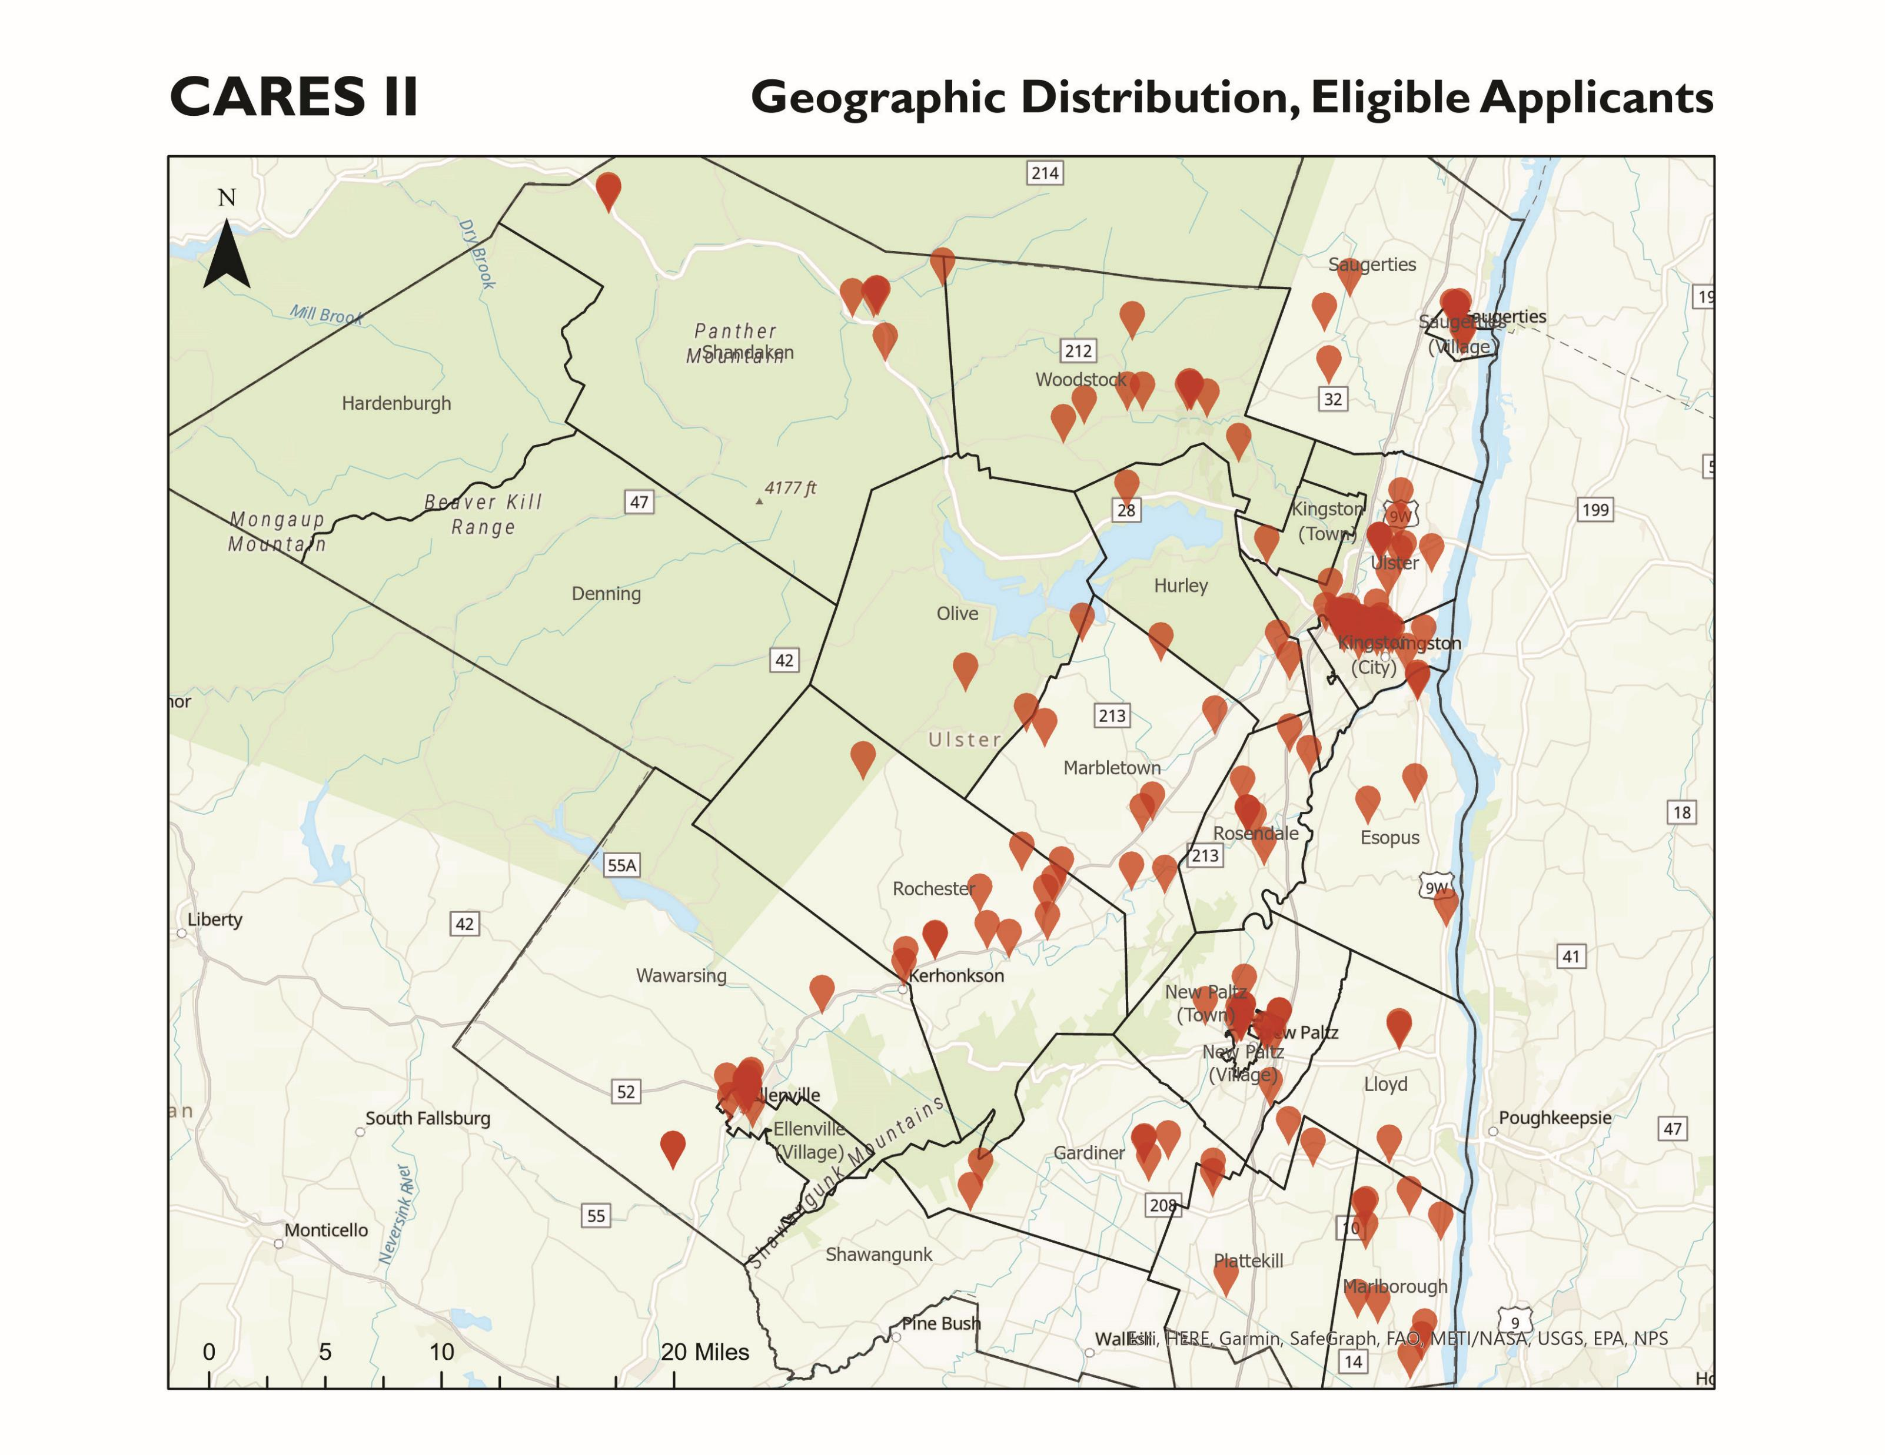
CARES II Applicant Geography
Ellenville (Village) | 14
Esopus | 5
Gardiner | 6
Hurley | 3
Kingston (City) | 42
Kingston (Town) | 1
Lloyd | 4
Marbletown | 9
Marlborough | 10
New Paltz (Town) | 8
New Paltz (Village) | 8
Olive | 1
Plattekill | 4
Rochester | 12
Rosendale | 7
Saugerties | 3
Saugerties (Village) | 11
Shandaken | 8
Ulster | 10
Wawarsing | 4
Woodstock | 11

Slide 6
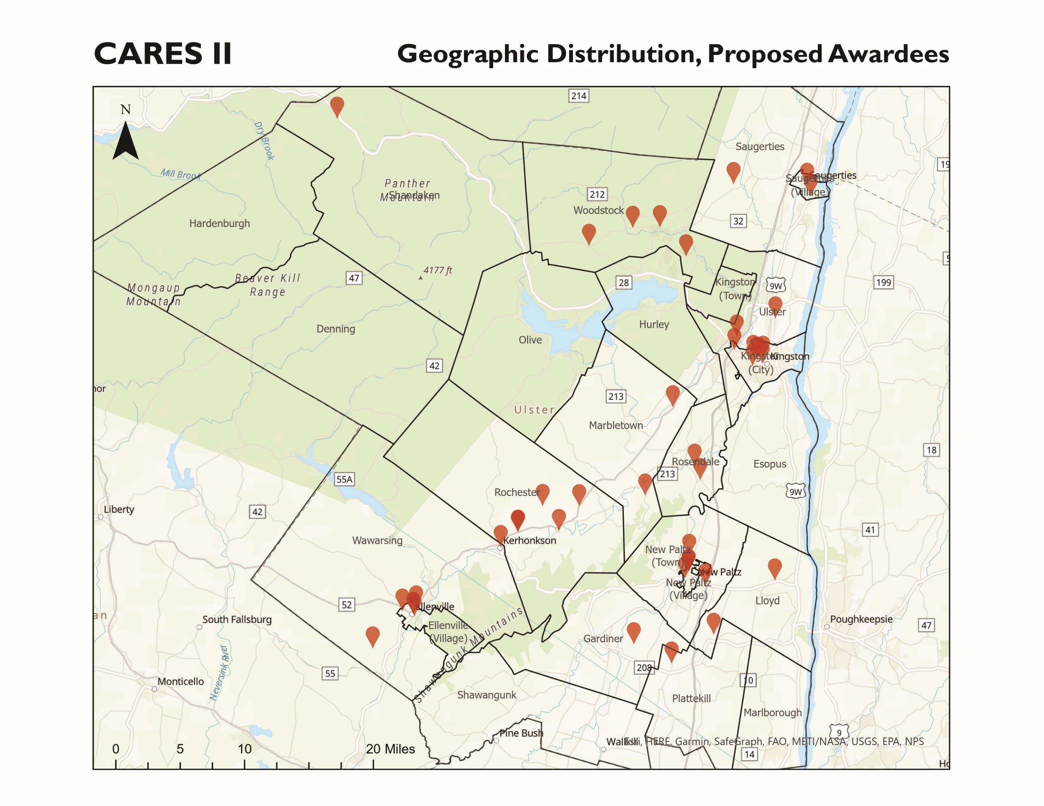
CARES II Applicant Geography
Kingston (City) | 6
Rochester | 5
Ellenville (Village) | 4
Woodstock | 4
New Paltz (Village) | 3
New Paltz (Town) | 3
Lloyd | 2
Marbletown | 2
Rosendale | 2
Saugerties (Village) | 2
Ulster | 2
Wawarsing | 2
Gardiner | 1
Plattekill | 1
Saugerties (Town) | 1
Shandaken | 1
TOTAL | 41

Slide 7
Contract Schedule A Example

Slide 8
Contract Schedule B Example

